Slide 1
SQL – PROJECT
Super market Store Analysis
By – Sourabh Patil

Slide 2
SQL
SQL (Structured Query Language) is a language used to communicate with databases.
It works with most databases like MySQL, PostgreSQL, Oracle, and SQL Server.
In this we analyze the super store dataset can downloaded from below link for reference.
Link – https://www.kaggle.com/datasets/bravehart101/sample-supermarket-dataset

Slide 3
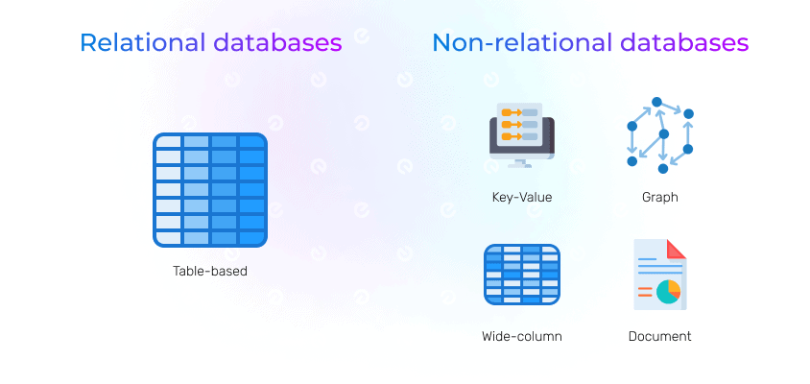
Database
What is Database
Database is collection of well organize data,that can be easily accessed, managed, and updated.
Types Of Database :
1. Relational Database(RDBMS) : Where data is well organize in tabular format.
2. NoSQL Database(NRDBMS) : Where data is in key value pair format

Slide 4
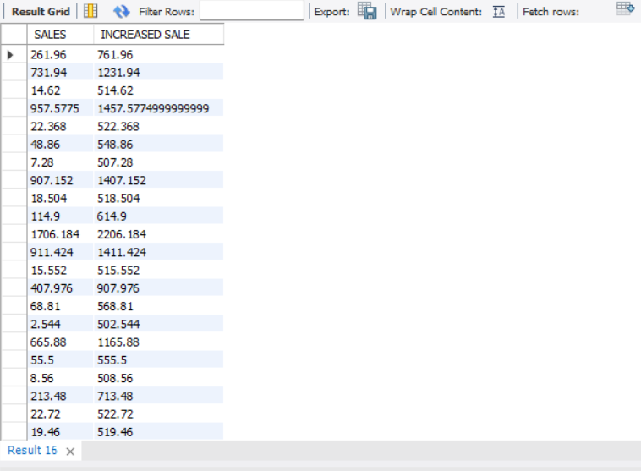
ARITHMETIC OPERATORS
Q.1 : WRITE A QUERY TO DISPLAY SALES AND INCREASED SALES BY 500 FROM SUPER STORE DATA.
QUERY :
SELECT SALES, SALES+500 AS “INCREASED SALE”
FROM SUPER_STORE_DATA;
OUTPUT :

Slide 5
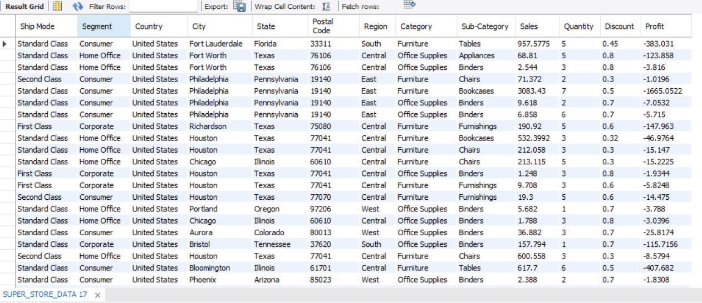
LOGICAL OPERATORS (OR)
Q.2 : WRITE A QUERY TO DISPLAY ALL RECORDS WHERE PROFIT IS GREATER THEN 500 OR DISCOUNT GREATER THAN 0.2.
QUERY :
SELECT *
FROM SUPER_DATA_STORE
WHERE PROFIT > 500
OR DISCOUNT > 0.2;
OUTPUT :

Slide 6
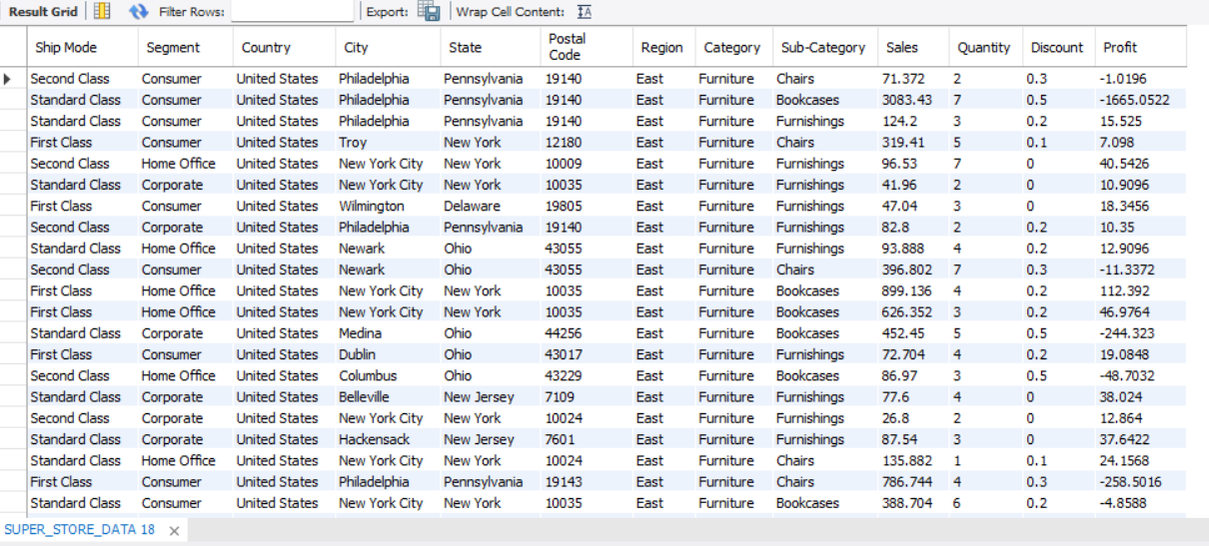
LOGICAL OPERATORS (AND)
Q.3 : WRITE A QUERY TO DISPLAY ALL RECORDS WHERE REGION IS EAST AND CATEGORY IS FURNITURE.
QUERY :
SELECT *
FROM SUPER_DATA_STORE
WHERE REGION = ‘EAST’
AND CATEGORY = ‘FURNITURE’;
OUTPUT :

Slide 7
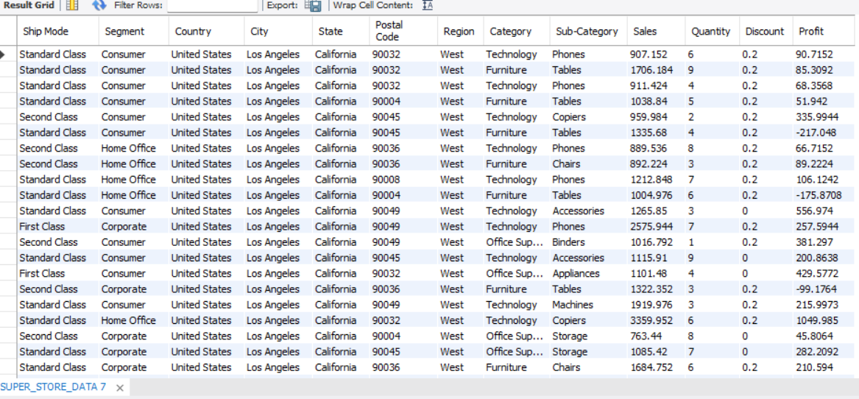
LOGICAL OPERATORS
Q.4 : WRITE A QUERY TO DISPLAY ALL RECORDS WHERE CITY IS ‘LOS ANGELES’ AND PROFIT IS GRETER THAN 1000.
QUERY :
SELECT *
FROM SUPER_STORE_DATA
WHERE CITY = ‘LOS ANGELES’
AND SALES > 700 ;
OUTPUT :

Slide 8
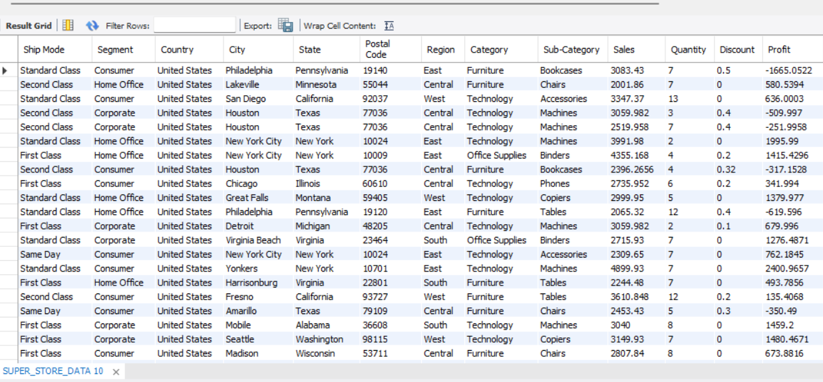
BETWEEN AND OPERATORS
Q.5 : WRITE A QUERY TO FIND ALL RECORDS WITH SALES BETWEEN 2000 AND 5000 .
QUERY :
SELECT *
FROM SUPER_STORE_DATA
WHERE SALES BETWEEN 2000 AND 5000;
OUTPUT :

Slide 9
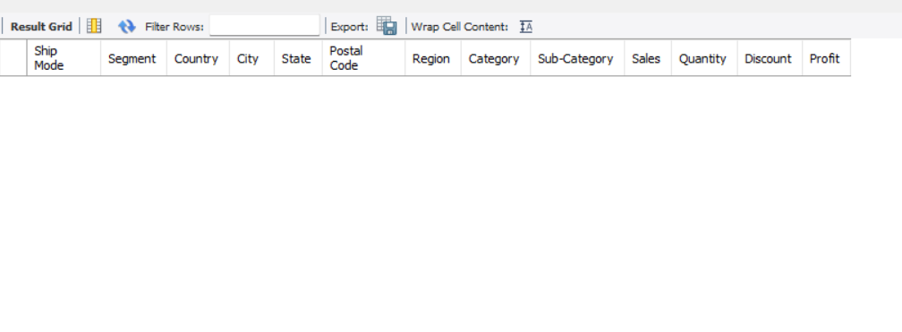
IS NULL OPERATORS
Q.6 : WRITE A QUERY TO FIND ALL RECORDS WHERE QUANTITY IS NULL.
QUERY :
SELECT *
FROM SUPER_STORE_DATA
WHERE QUANTITY IS NULL;
OUTPUT :

Slide 10
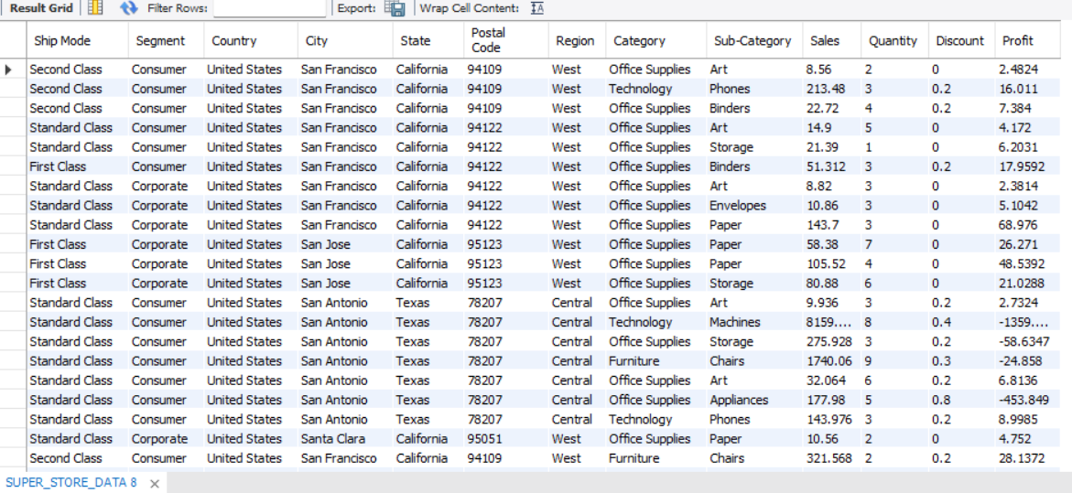
LIKE OPERATORS
Q.7 : WRITE A QUERY TO DISPLAY ALL RECORDS WHERE CITY NAME START WITH ‘SAN’.
QUERY :
SELECT *
FROM SUPER_STORE_DATA
WHERE CITY LIKE ‘SAN%’;
OUTPUT :

Slide 11
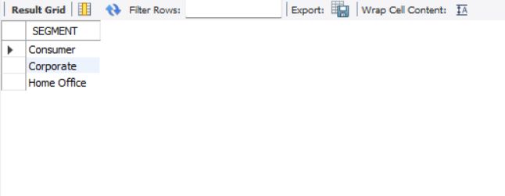
UNIQUE OPERATORS
Q.8 : WRITE A QUERY TO DISPLAY UNIQUE SEGMENT FROM SUPER STORE DATA.
QUERY :
SELECT DISTINCT(SEGMENT)
FROM SUPER_STORE_DATA;
OUTPUT :

Slide 12
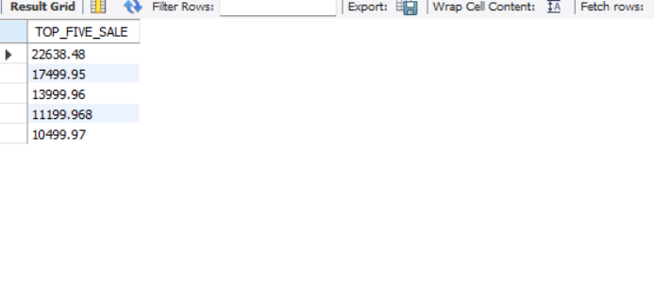
LIMIT AND OFFSET OPERATORS
Q.9 : WRITE A QUERY TO DISPLAY TOP 5 SALES.
QUERY :
SELECT SALES AS TOP_FIVE_SALE
ORDER BY DESC
LIMIT 5;
OUTPUT :

Slide 13
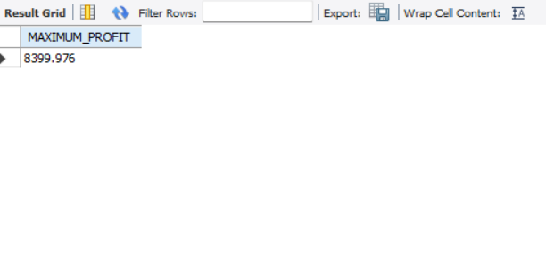
MAX FUNCTIONS
Q.10 : WRITE A QUERY TO FIND MAXIMUM PROFIT FROM SUPER STORE DATA TABLE.
QUERY :
SELECT MAX(PROFIT) AS 'MAXIMUM_PROFIT'
FROM SUPER_STORE_DATA;
OUTPUT :

Slide 14
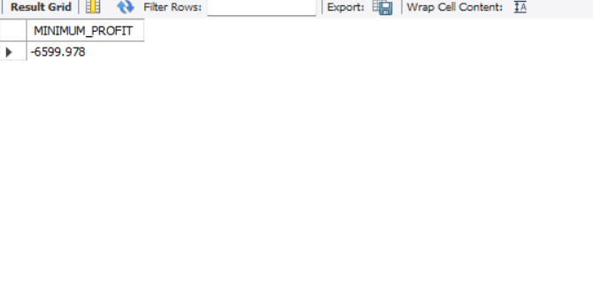
MIN FUNCTIONS
Q.11 : WRITE A QUERY TO FIND MINIMUM SALES FROM SUPER DATA STORE.
QUERY :
SELECT MIN(PROFIT) AS ‘MINIMUM_PROFIT'
FROM SUPER_STORE_DATA;
OUTPUT :

Slide 15
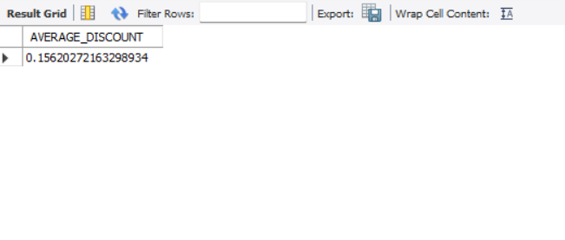
AVG FUNCTIONS
Q.12 : WRITE A QUERY TO FIND AVERAGE DISCOUNT FROM SUPER DATA STORE.
QUERY :
SELECT AVG(DISCOUNT) AS ‘AVERAGE_DISCOUNT'
FROM SUPER_STORE_DATA;
OUTPUT :

Slide 16
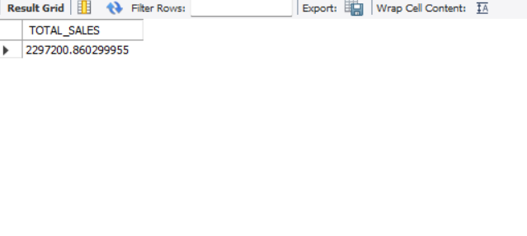
SUM FUNCTIONS
Q.13 : WRITE A QUERY TO CALCULATE THE TOTAL SALES FROM SUPER DATA STORE.
QUERY :
SELECT SUM(SALES) AS ‘TOTAL_SALES'
FROM SUPER_STORE_DATA;
OUTPUT :

Slide 17
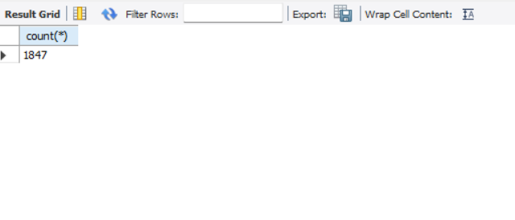
COUNT FUNCTIONS
Q.14 : WRITE A QUERY TO COUNT HOW MANY RECORDS EXIST FOR TECHNOLOGY CATEGORY.
QUERY :
SELECT COUNT(*)
FROM SUPER_STORE_DATA
WHERE CATEGORY = ‘TECHNOLOGY’;
OUTPUT :

Slide 18
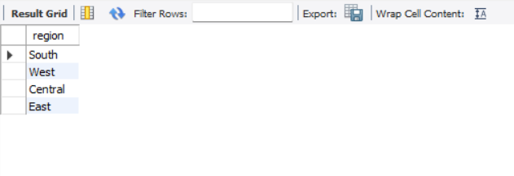
Single row FUNCTIONS
Q.15 : WRITE A QUERY TO unique region in upper case.
QUERY : select distinct((region)) from SUPER_STORE_DATA;
OUTPUT :

Slide 19
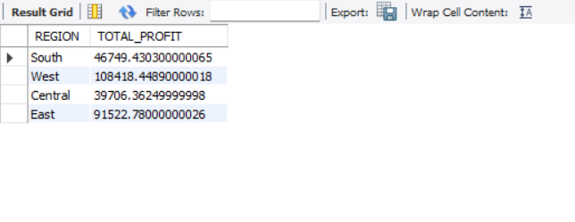
GROUP BY CLAUSE
Q.16 : WRITE A QUERY TO DISPLAY REGION AND TOTAL PROFIT.
QUERY :
SELECT REGION, SUM(PROFIT) AS ‘TOTAL_PROFIT’
FROM SUPER_STORE_DATA
GROUP BY REGION;
OUTPUT :

Slide 20
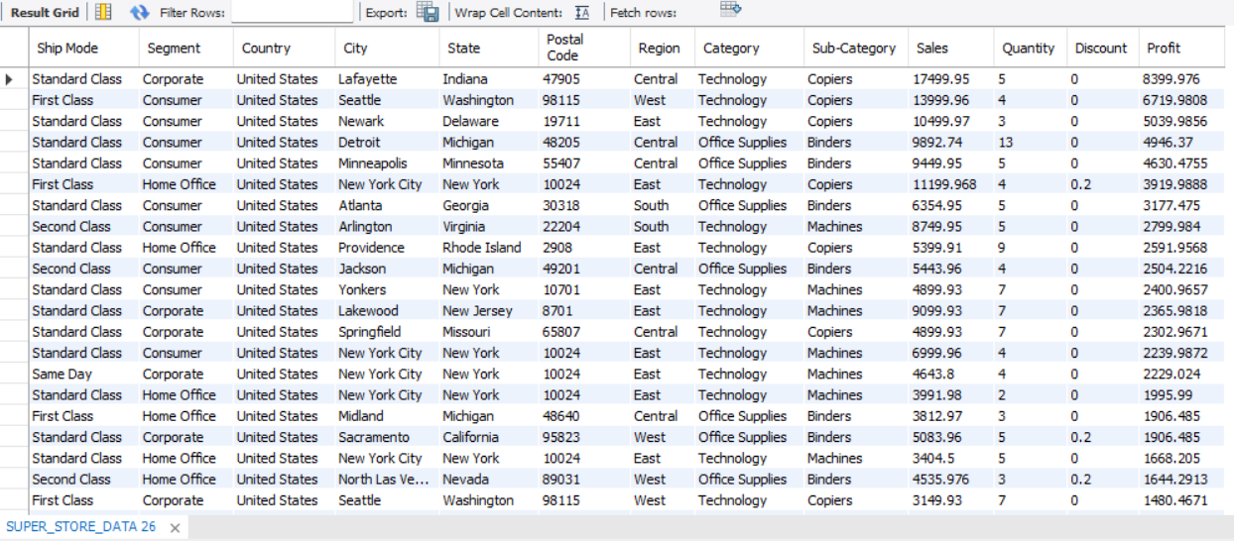
ORDER BY CLAUSE
Q.17 : WRITE A QUERY TO DISPLAY ALL RECORDS SORTED BY PROFIT IN DECENDING ORDER.
QUERY :
SELECT *
FROM SUPER_STORE_DATA
ORDER BY PROFIT DESC;
OUTPUT :

Slide 21
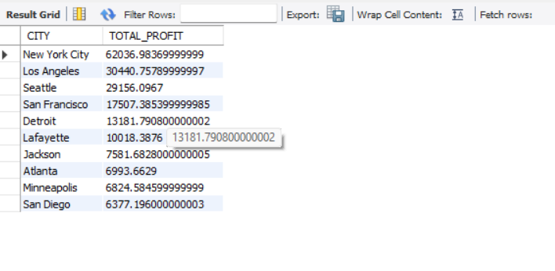
GROUP BY AND ORDER BY CLAUSE
Q.18 : WRITE A QUERY TO DISPLAY TOP 10 CITIES WITH HIGHEST PROFIT.
QUERY :
SELECT CITY, SUM(PROFIT) AS TOTAL_PROFIT
FROM SUPER_STORE_DATA
GROUP BY CITY
ORDER BY TOTAL_PROFIT DESC
LIMIT 10;
OUTPUT :

Slide 22
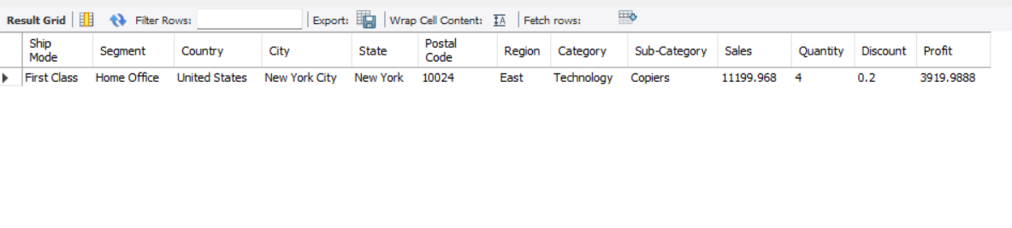
OFFSET AND LIMIT
Q.19 : Write a query to find the 5th Maximum Profit across all records.
QUERY : SELECT * FROM SUPER_STORE_DATA order by PROFIT DESC LIMIT 1 OFFSET 5;
OUTPUT :

Slide 23
SUB QUERY
Q.20 : WRITE A QUERY TO RETRIEVE 10 RECORDS FROM SUPER DATA STORE WHERE SALES ARE ABOVE THE AVERAGE SALES OF ALL RECORDS.
QUERY :
SELECT CITY, SUM(PROFIT) AS TOTAL_PROFIT
FROM SUPER_STORE_DATA
GROUP BY CITY
ORDER BY TOTAL_PROFIT DESC
LIMIT 10;
OUTPUT :

Slide 24
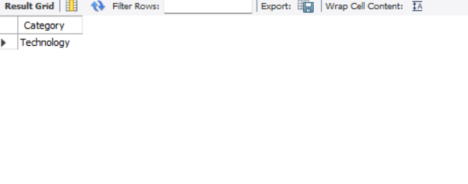
Q.21 : WRITE A QUERY TO display the category that has the minimum profit.
QUERY :
SELECT category from SUPER_STORE_DATA where profit =
(select min(profit) from SUPER_STORE_DATA);
OUTPUT :

Slide 25
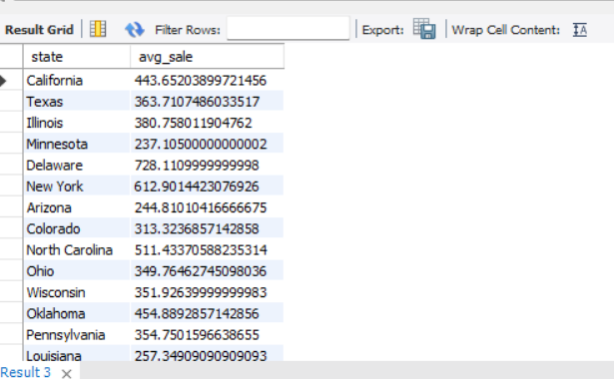
Q.22 : WRITE A QUERY TO display average sales Technology of in each state.
QUERY :
select state, avg(sales) as avg_sale from SUPER_STORE_DATA where category = 'technology’ group by state;
OUTPUT :

Slide 26
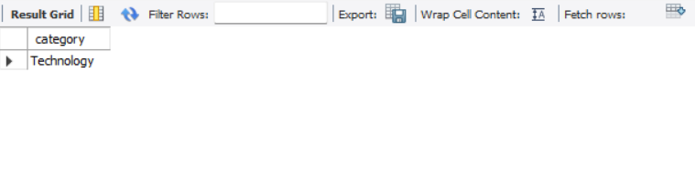
Q.23 : WRITE A QUERY TO display category with lowest total discount.
QUERY :
select category from SUPER_STORE_DATA
group by category
order by sum(discount) asc limit 1;
OUTPUT :

Slide 27
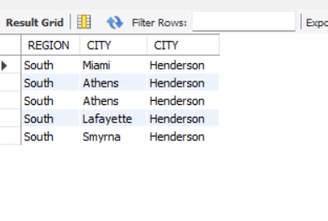
INNER JOIN
Q.24 : WRITE A QUERY TO RETRIEVE 5 MATCH ORDERS FROM THE SAME REGION BUT DIFFERENT CITIES.
QUERY : SELECT S1.REGION, S1.CITY, S2.CITY FROM SUPER_STORE_DATA S1 inner join SUPER_STORE_DATA S2 ON S1.REGION = S2.REGION AND S1.CITY != S2.CITY LIMIT 5;
OUTPUT :

Slide 28
THANK YOU

